Slide 1



Final Project BDAT1001
Information Encoding Standards
Group 4: Rajat Rathi, Xuejie Jiang, Abhinay Negi
Apr 12, 2022

Slide 2
CONTENTS
01
Project Summary
02
Group Members
03
User data protected by authorization
04
Security Technologies Recommendations

Slide 3

1
Project Summary
St
Group Members
User data protected by authorization
Security Technologies Recommendations

Slide 4

Project Summary
In the era of big data, people's lifestyles, daily habits, and modes of thinking have undergone earth-shaking changes. Big data has become an important topic for research in industry and academia. But big data is a double-edged sword. It brings convenience to people and brings certain risks. In the process of data collection, storage, and use, it can easily lead to the leakage of personal information, and the fact that data is difficult to discern. How to ensure big data security and privacy protection has become one of the hot issues in the current stage of research.

Slide 5

2
Project Summary
nd
Group Members
User data protected by authorization
Security Technologies Recommendations

Slide 6
Group Members
1
Rajat Rathi
2
Xuejie Jiang
3
Abhinay Negi

Slide 7

3
Project Summary
Group Members
rd
User data protected by authorization
Security Technologies Recommendations

Slide 8
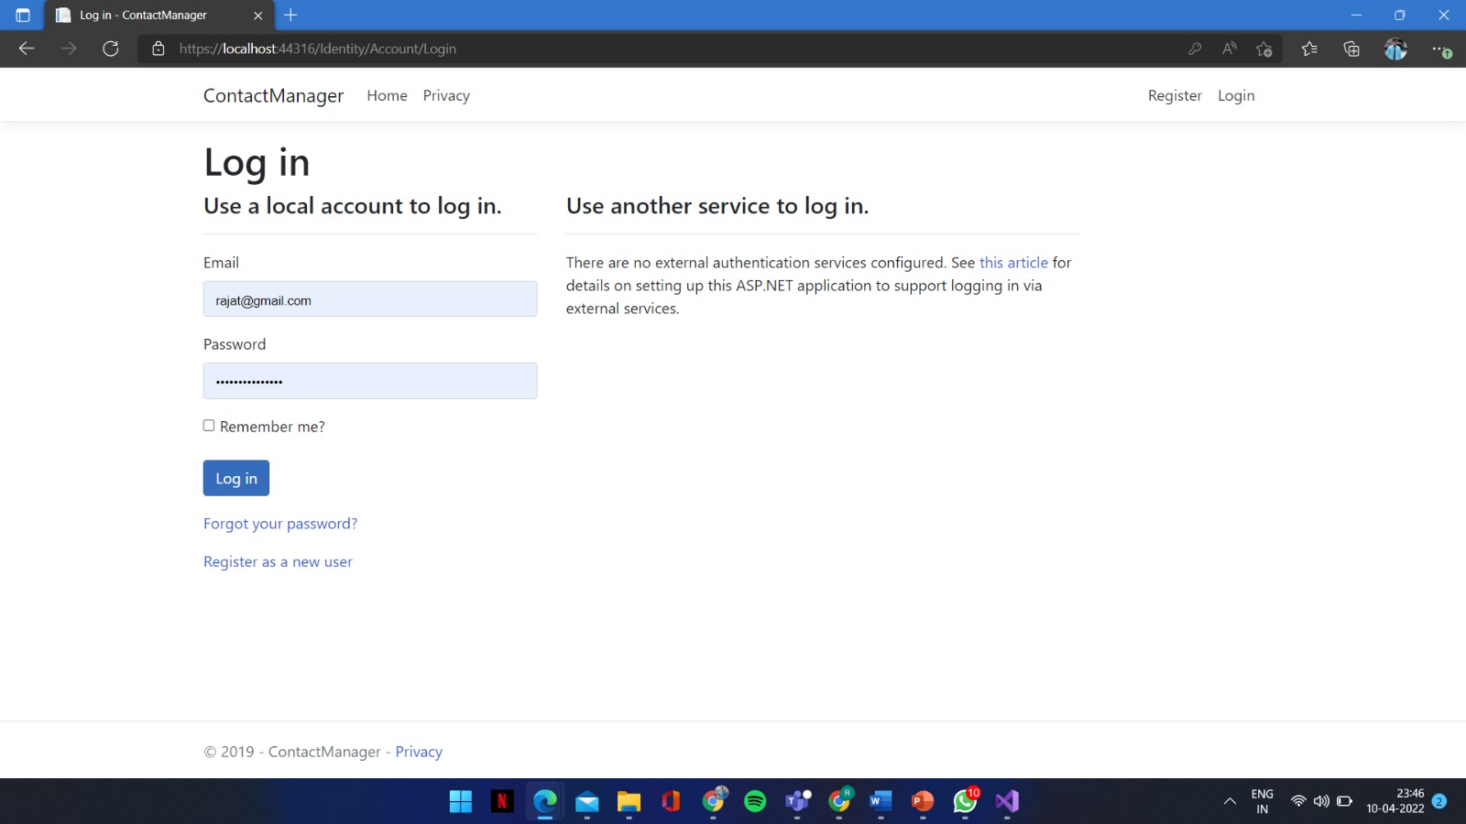
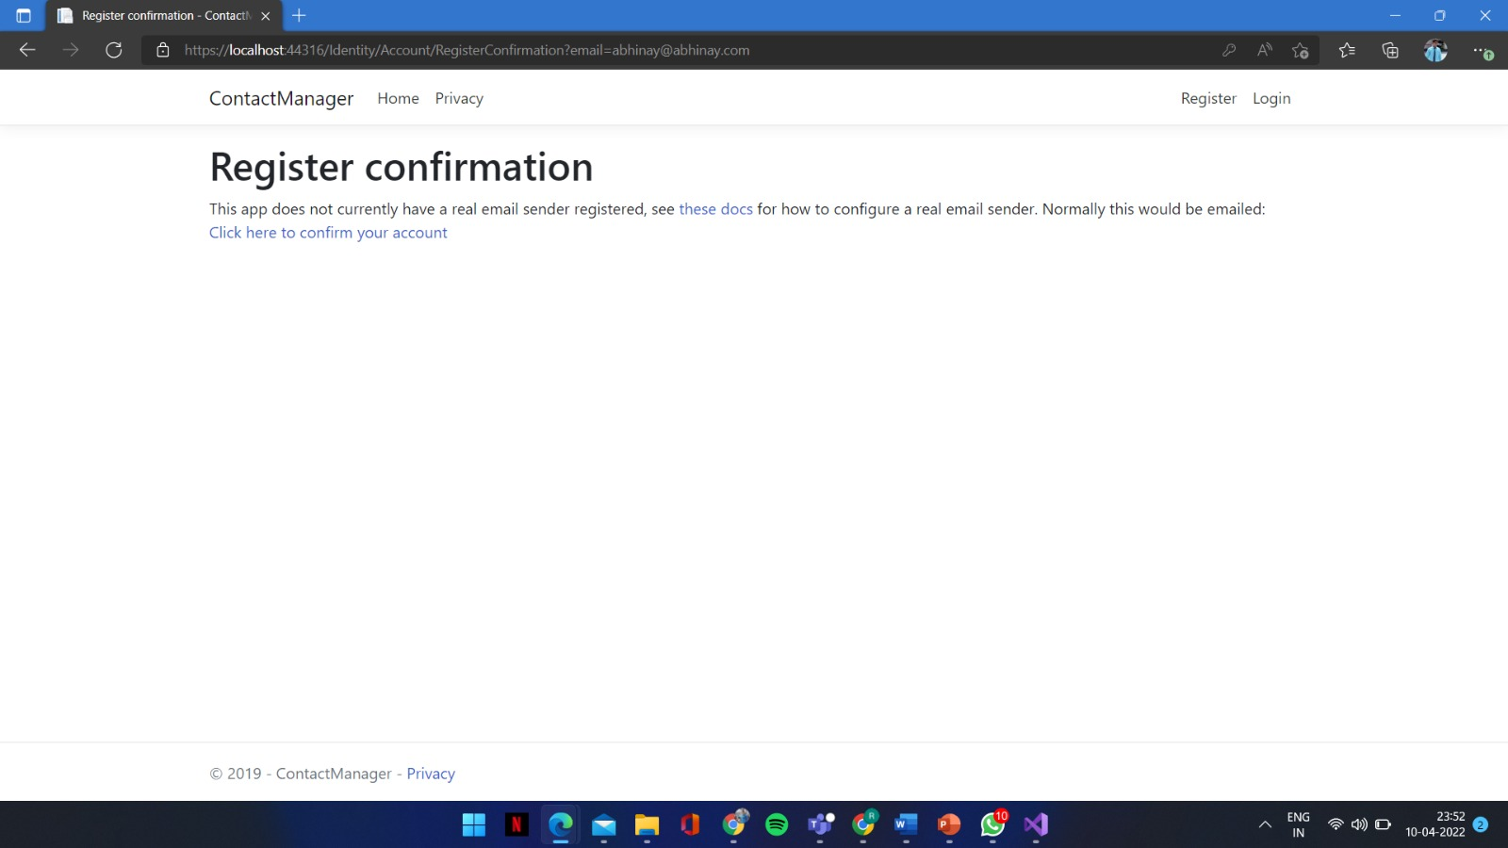
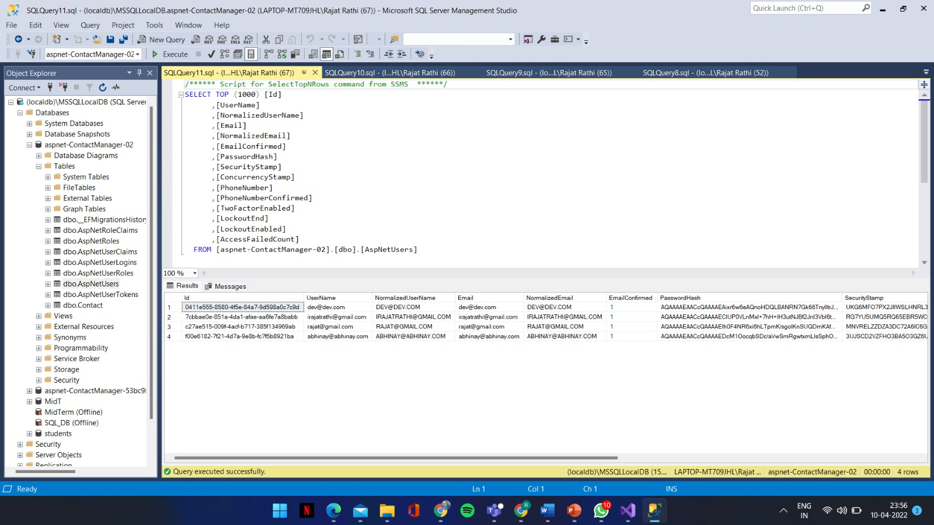
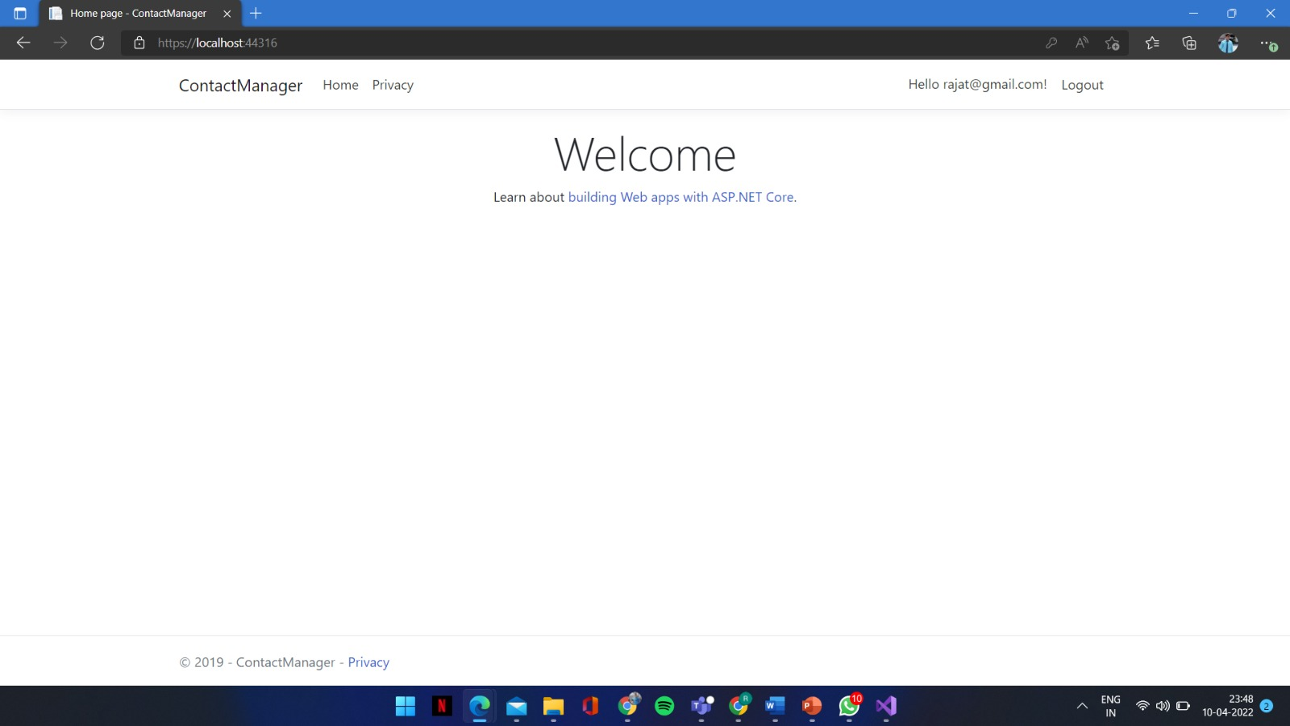
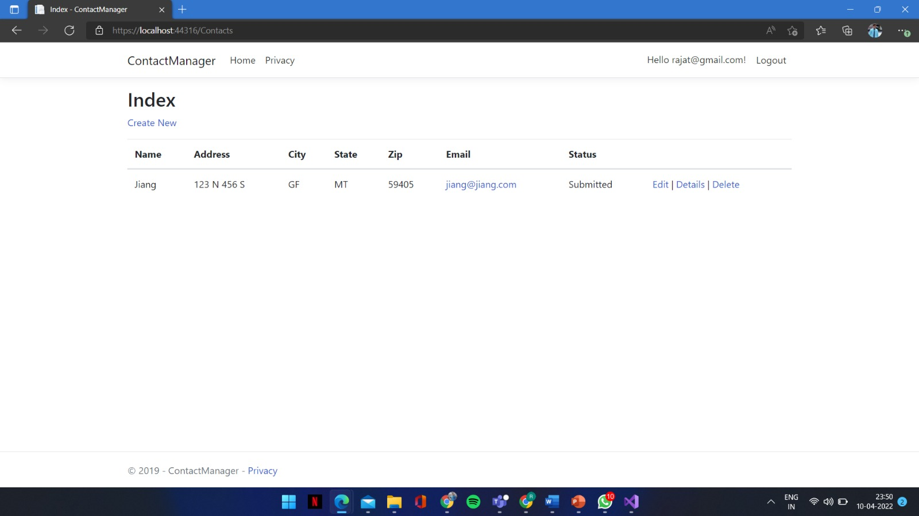
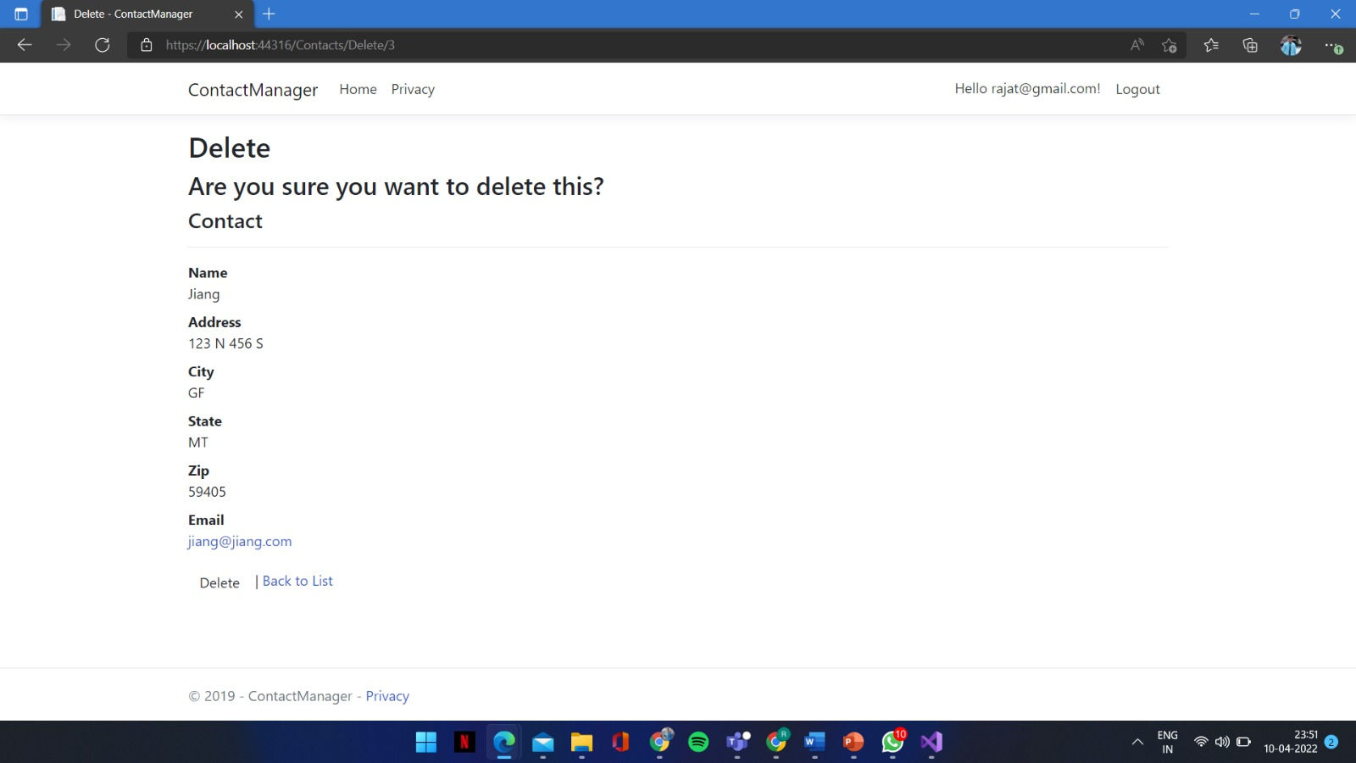
User data protected by authorization

Slide 9

4
Project Summary
Group Members
th
User data protected by authorization
Security Technologies Recommendations

Slide 10



Security Technologies Recommendations
Question 1
How can we transfer personal data securely within their network?
Answer
We can use Virtual Private Network (VPN) , which is a secure, encrypted tunnel that connects two or more devices.

Slide 11
Security Technologies Recommendations
Question 2
What security protocol is best for transferring personal files?
Answer
SSH File Transfer Protocol (SFTP)
SFTP is a protocol developed by the Internet Engineering Task Force (IETF) and is the most common file transfer protocol in use today. SFTP is built on Secure Shell cryptography to encrypt data being transferred.

Slide 12
Security Technologies Recommendations
Question 3
Can we encode and encrypt images?
Answer
Yes. A picture can be encrypted in the same way that text is encrypted by software. This software can be used to encrypt the image so that it is unreadable by unauthorized individuals.

Slide 13
Security Technologies Recommendations
Question 4
Our database cannot be moved from the site, and we need to be able to access it externally using a secure API. Can you explain the architecture of a secure API?
Answer
A secure API is one that controls access to the API through authentication and authorization.

Slide 14


Security Technologies Recommendations
Question 5
Can you recommend a secure framework for coding an API?
OAuth 2.0 is a popular secure framework for coding APIs. It allows users to securely access data and services from third-party applications. OAuth 2.0 is an open authorization standard that allows third-part applications to access data from a user’s account without requiring the user’s permission. OAuth 2.0 is commonly used by social media platforms and applications to grant access to user data.
OAuth 2.0

Slide 15
Security Technologies Recommendations
Question 6
What data interchange format should we use while transferring data between locations?
Answer
JSON has become ubiquitous on the web. Today it is the format of choice for almost every publicly available web service, and it is frequently used for private web services as well.

Slide 16
Security Technologies Recommendations
Question 7
How should we store our data in our many locations?
Answer
We can store the data in Cloud. Cloud storage solutions to make it easier to access data from multiple locations. Cloud storage has removed some of the need to keep files on computers because it offers an organized way to find, share, and control the information.

Slide 17





Security Technologies Recommendations
Question 8: What are the ethical concerns related to the transmission of personal data?
Availability of data content, and the data subject’s legal right to access, and ownership
Inappropriate use of data
Freedom from unauthorized access to private data
Accuracy and completeness when collecting data about a person or persons (corporations included) by technology
The rights to inspect, update or correct these data

Slide 18


THANKS

